Slide 1



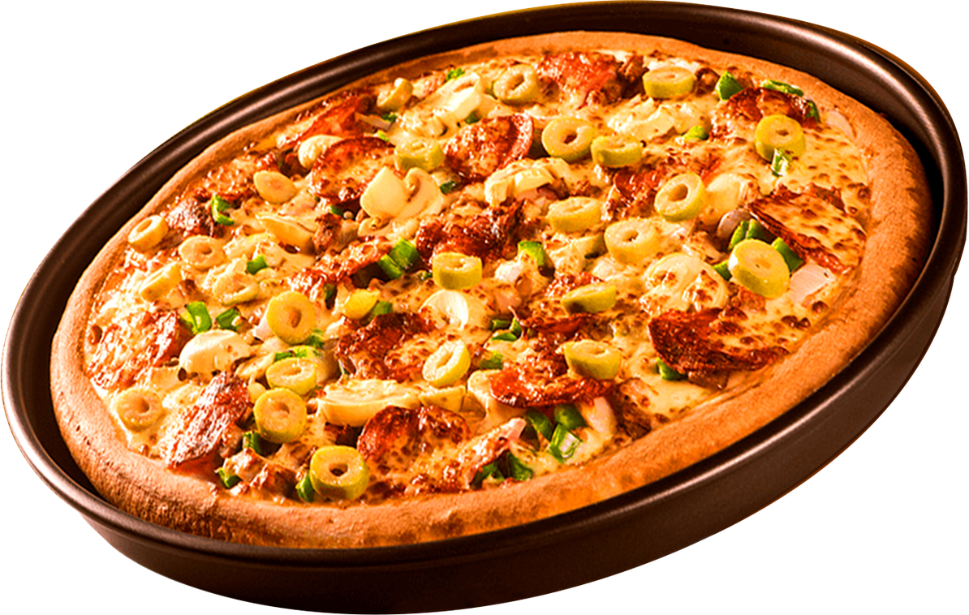

PIZZA SALES
Overview
Insights
Growth
ANALYSIS
PIZZA SALES
PERFORMANCE ANALYSIS
DATA-DRIVEN INSIGHTS & BUSINESS INTELLIGENCE USING SQL
PRESENTED BY
YOGESH ADHANA | JAN 2026

Slide 2

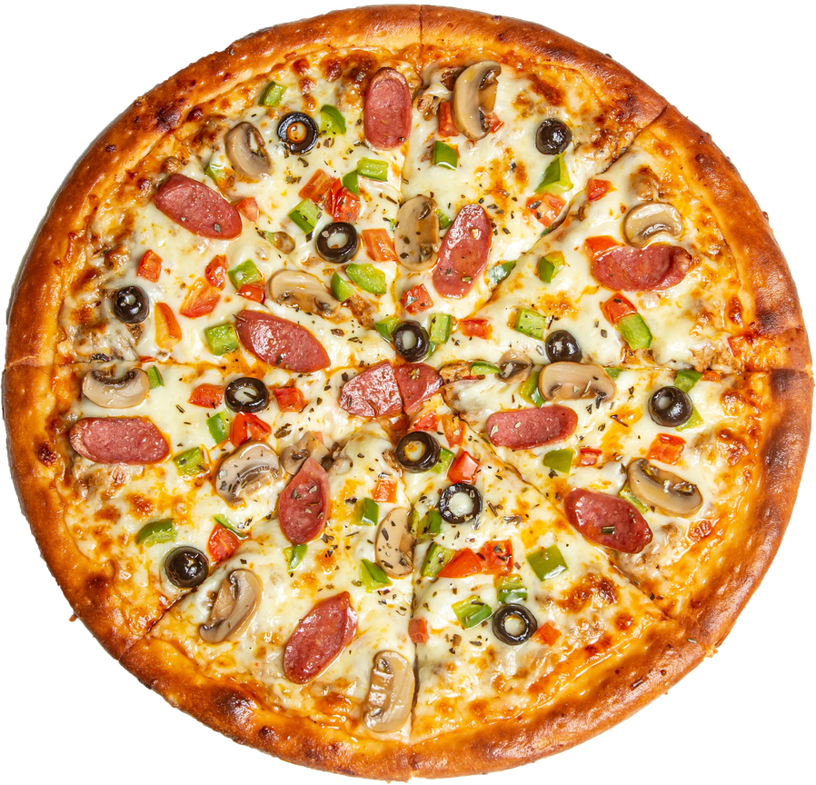
PIZZA SALES
Overview
Insights
Growth
ANALYSIS
OBJECTIVE
The primary goal of this project is to conduct a comprehensive Sales Performance Analysis for a pizza franchise. By leveraging SQL, we aim to extract actionable insights regarding customer behavior, product popularity, and revenue growth to support data-driven decision-making.

Slide 3

PIZZA SALES
Overview
Insights
Growth
ANALYSIS
ANALYTICAL APPROACH
The project was divided into three levels of complexity to ensure a 360-degree view of the business:
Basic: General descriptive statistics (Total revenue, order volume).
Intermediate: Trend analysis and table joins (Hourly patterns, category performance).
Advanced: Deep-dive metrics (Percentage contributions and cumulative growth).

Slide 4
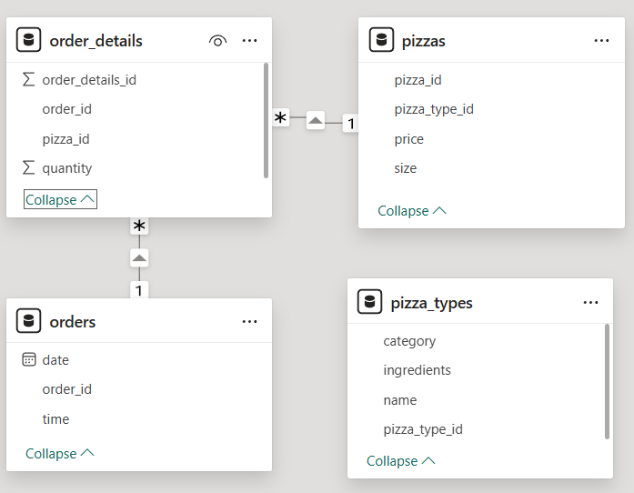
PIZZA SALES
DATA SET
ANALYSIS
The analysis is based on a relational database containing four interconnected tables:
orders: Records the Date and Time of every transaction.
order_Details: Contains the quantity and specific pizzas associated with each order ID.
pizzas: Stores the size and price for every pizza variant.
pizza_Types: Includes descriptive metadata like Category (Veggie, Classic, etc.) and Ingredients.
SCHEMA

Slide 5
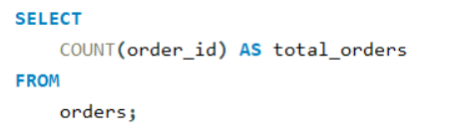
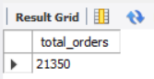
PIZZA SALES
ANALYSIS
Retrieve the total number of orders placed.
Query
Result

Slide 6
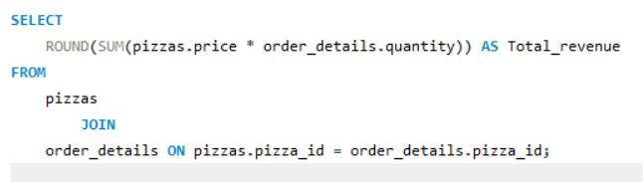
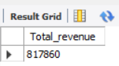
PIZZA SALES
ANALYSIS
Calculate the total revenue generated from pizza sales.
Query
Result

Slide 7
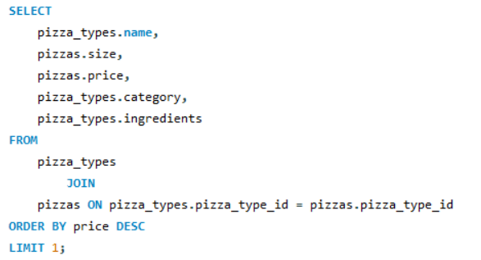
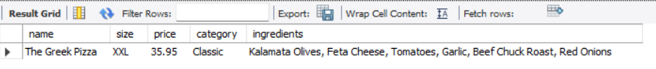
PIZZA SALES
Identify the highest-priced pizza.
ANALYSIS
Query
Result

Slide 8
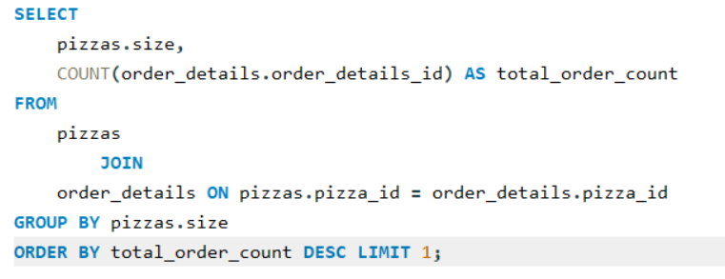
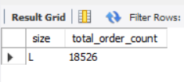
PIZZA SALES
Identify the most common pizza size ordered.
ANALYSIS
Query
Result

Slide 9
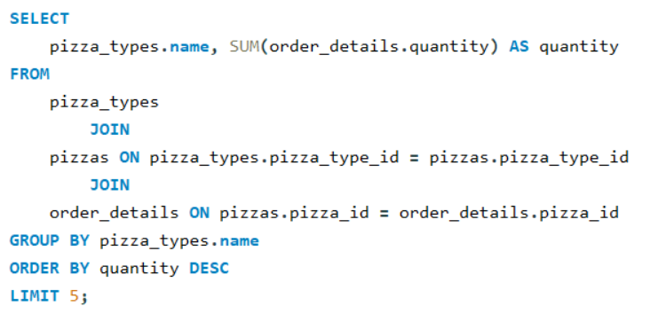
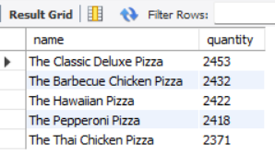
PIZZA SALES
ANALYSIS
List the top 5 most ordered pizza types along
with their quantities.
Query
Result

Slide 10
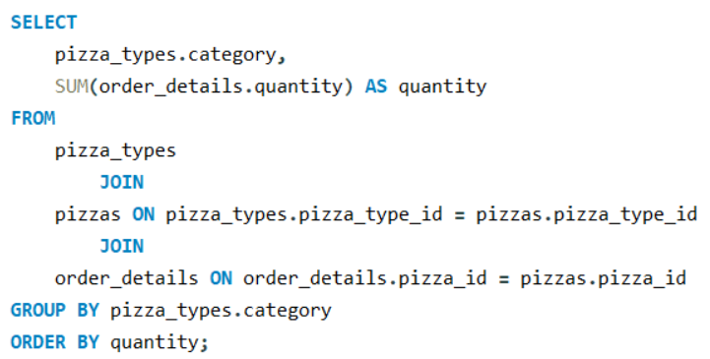
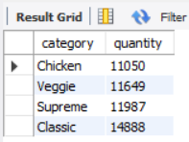
PIZZA SALES
ANALYSIS
Join the necessary tables to find the total quantity of each pizza category ordered.
Query
Result

Slide 11
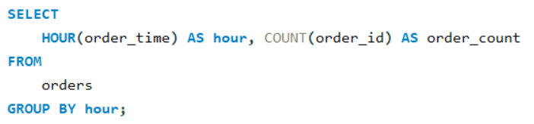
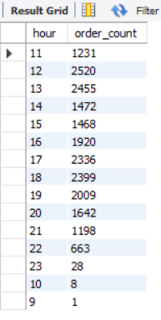
PIZZA SALES
ANALYSIS
Determine the distribution of orders by hour of the day.
Query
Result

Slide 12
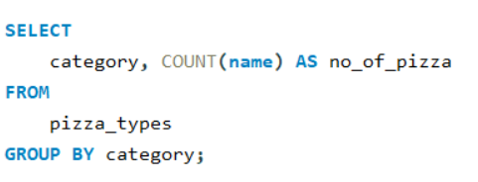
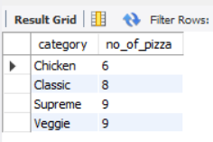
PIZZA SALES
ANALYSIS
Join relevant tables to find the category-wise distribution of pizzas.
Query
Result

Slide 13
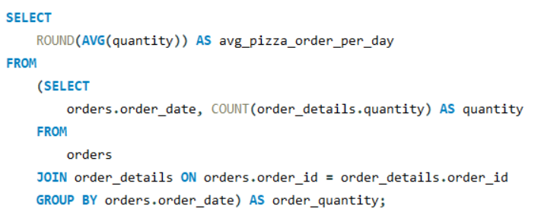
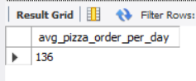
PIZZA SALES
ANALYSIS
Group the orders by date and calculate the average number of pizzas ordered per day.
Query
Result

Slide 14
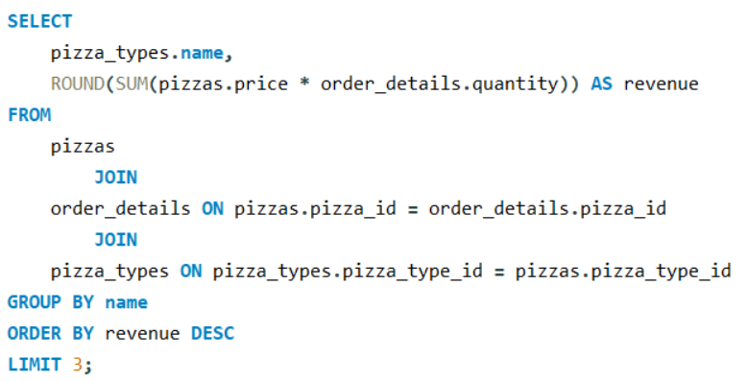
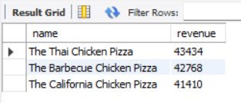
PIZZA SALES
ANALYSIS
Determine the top 3 most ordered pizza types based on revenue.
Query
Result

Slide 15
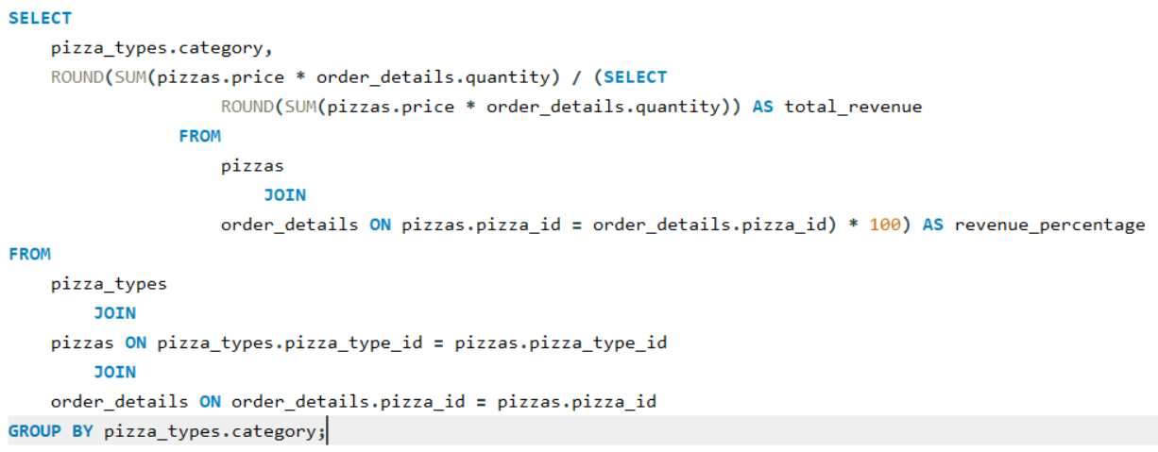
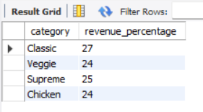
PIZZA SALES
Calculate the percentage contribution of each pizza type to total revenue.
ANALYSIS
Query
Result

Slide 16
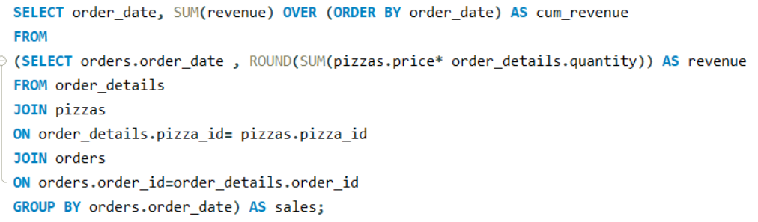
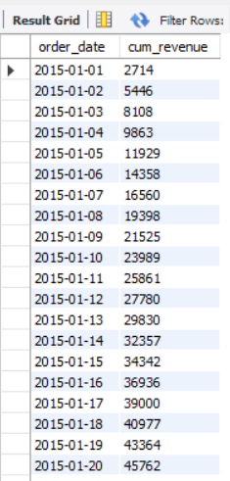
PIZZA SALES
ANALYSIS
Analyze the cumulative revenue generated over time.
Query
Result

Slide 17
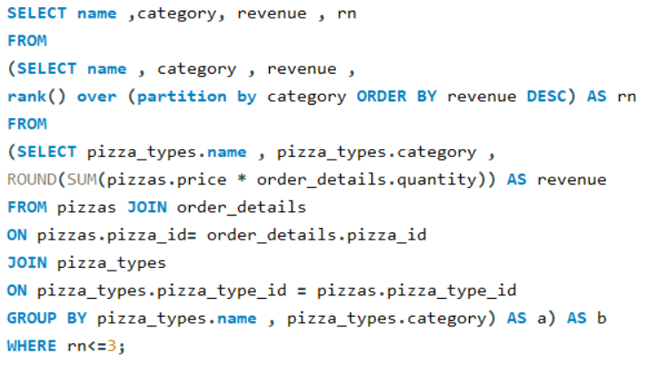
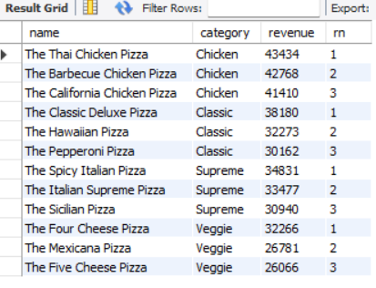
PIZZA SALES
Determine the top 3 most ordered pizza types based on revenue for each pizza category.
ANALYSIS
Query
Result

Slide 18
PIZZA SALES
Overview
Insights
Growth
ANALYSIS
KEY TAKEAWAYS
Revenue Drivers: Identified that CLASSIC is the primary revenue contributor, representing approximately 27% of total sales.
Operational Efficiency: Peak ordering hours occur at 12PM TO 2PM, suggesting a need for optimized staffing during these windows.
Customer Preference: The L(large) pizza size remains the most popular, indicating a standard for inventory and packaging procurement.

Slide 19
PIZZA SALES
Overview
Insights
Growth
ANALYSIS
STRATEGIC RECOMMENDATIONS
Inventory Optimization: Scale up stock for the top 5 most ordered pizza types to prevent stockouts during peak periods.
Promotional Targeting: Develop "bundle deals" for lower-performing categories (like chicken) to balance the contribution margin.
Customer Loyalty: Focus marketing efforts on the high-value ‘The Greek Pizza’ to increase the average order value (AOV).

Slide 20
PIZZA SALES
Overview
Insights
Growth
ANALYSIS
As we wrap up this analysis, it is important to remember that this project isn't just about 'counting pizzas'—it's about understanding the 'Health of the Business' through every transaction.
THANK YOU
YOGESH ADHANA | DATA ANALYST

